Slide 1
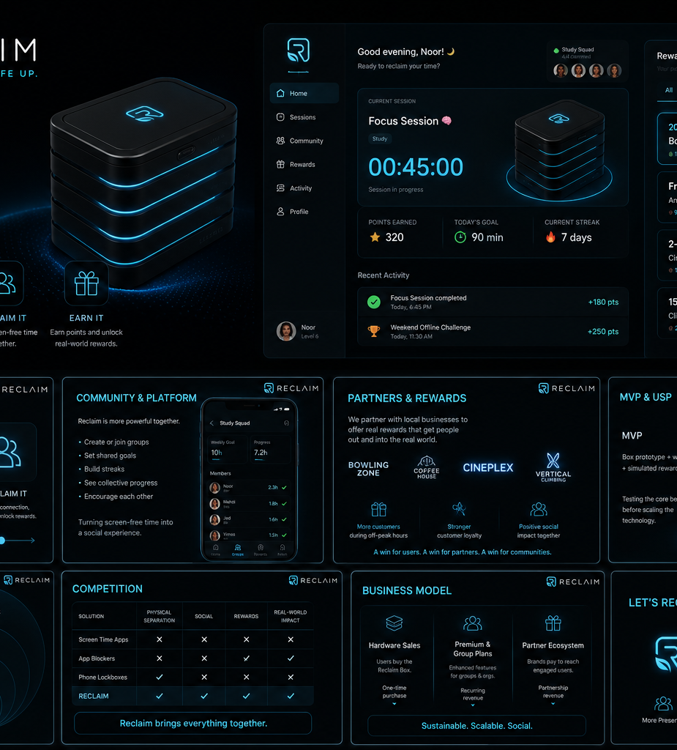

RECLAIM
Put it down. Pick life up.
Make screen-off time social and rewarding.

Slide 2
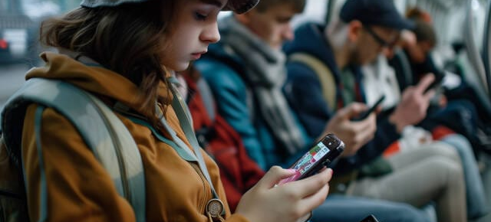
We're always connected — but not always present.
▶ VIDEO

Slide 3
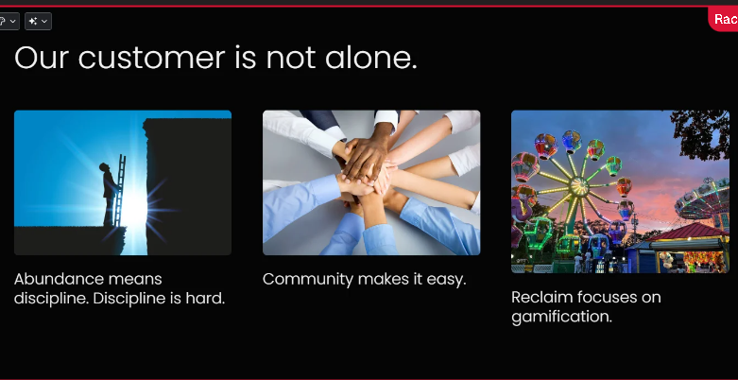

Slide 4
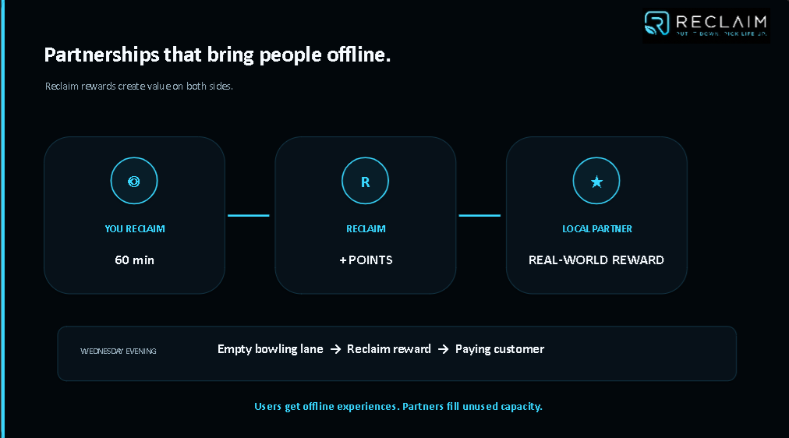

Slide 5
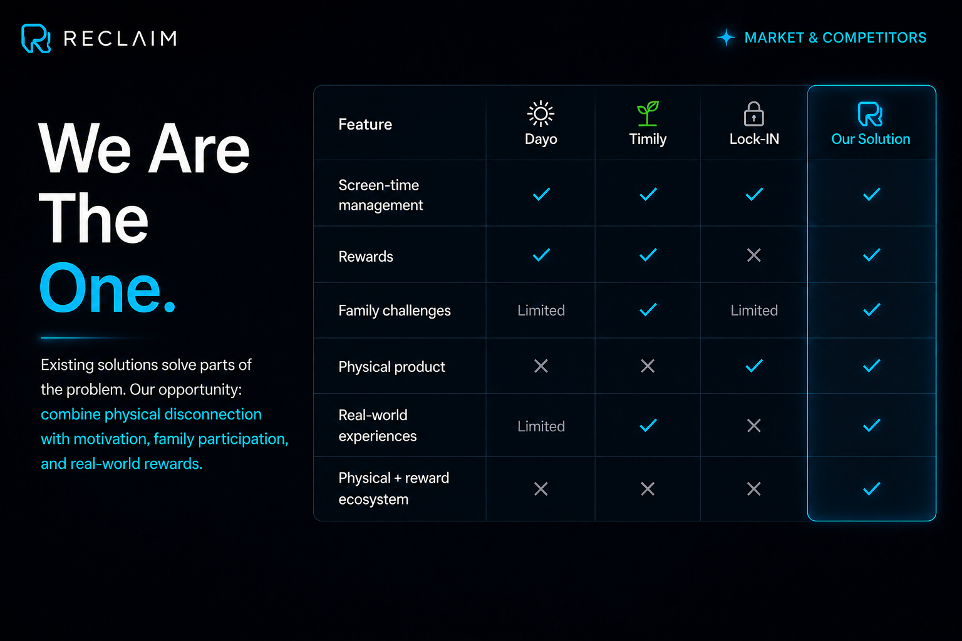

Slide 6
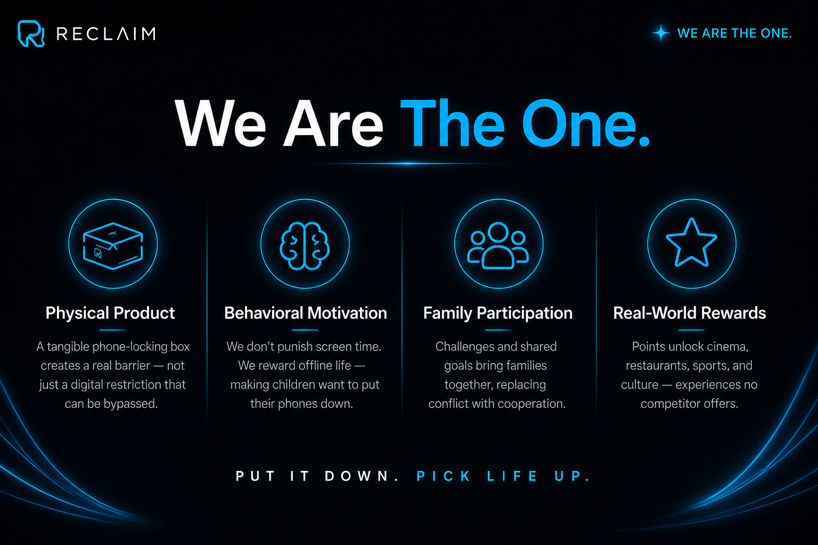

Slide 7
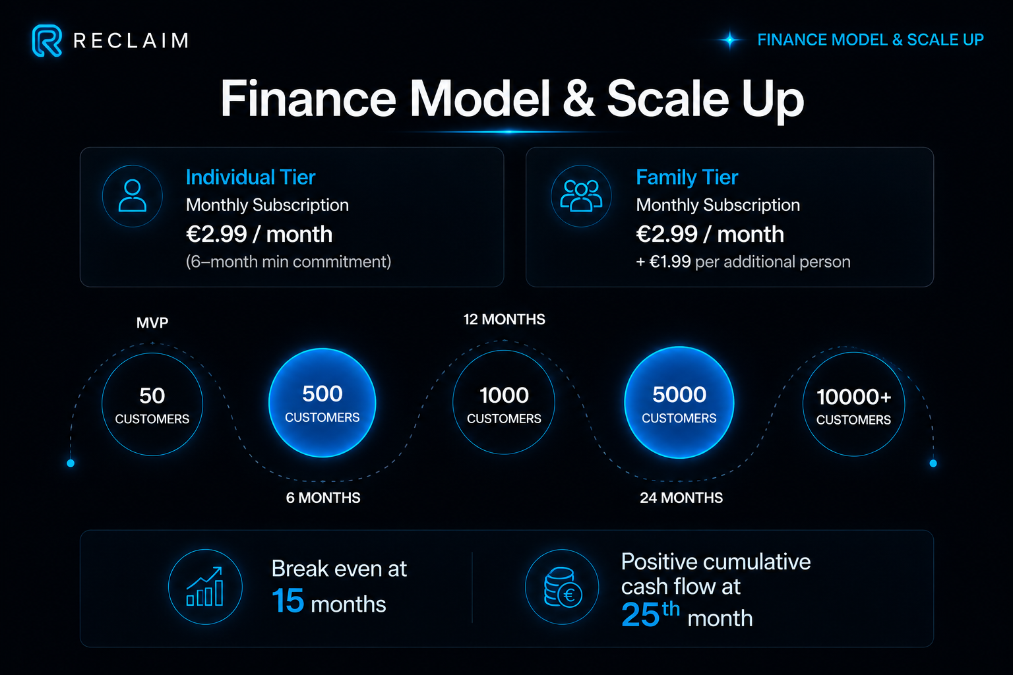

Slide 8
One phone away is a choice.
Doing it together is Reclaim.
Put it down. Pick life up.
STACK PHONES → END

